Slide 1
Module 2 Working with data: Data Visualizations

Slide 2
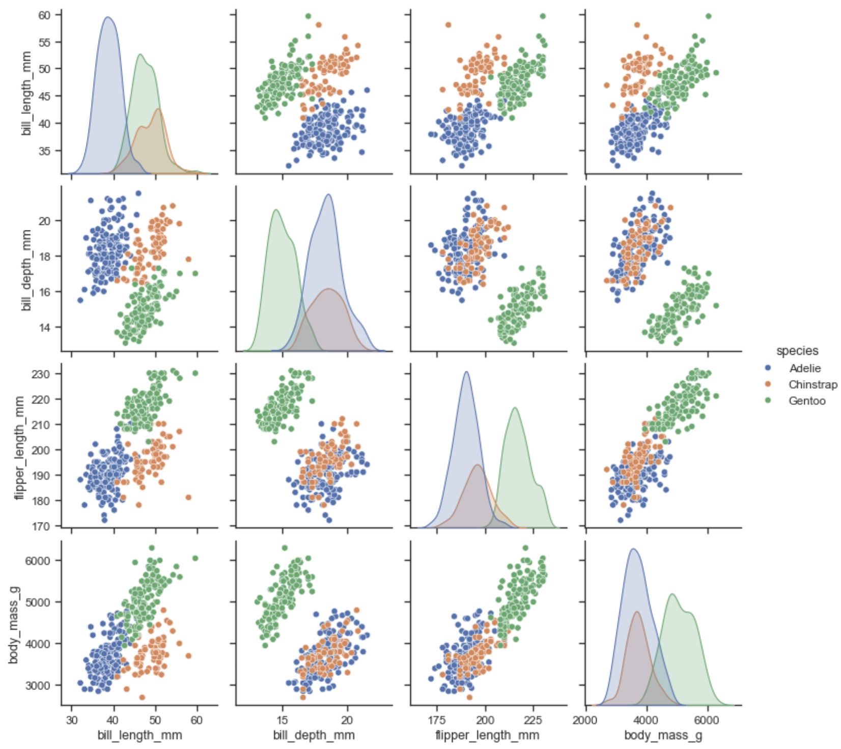
Data visualization overview
Visualizing biological data is a key part of preparing for a machine learning workflow
Understanding Data (structure, trends)
Identifying Outliers
Data Quality Assessment
Feature Selection
Pattern Recognition
Hypothesis Generation
Communicating Results
Model Validation
Seaborn Python Library

Slide 3

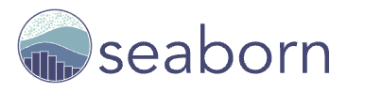
Data visualization in python
Matplotlib
Comprehensive data visualization library
Wide range of plot/graph types
Customizable options
Integrates with other Python libraries (e.g. Pandas, NumPy)
Seaborn
Built on top of Matplotlib
Advanced statistical plotting capabilities
Easier to use, better default aesthetics, new/additional features

Slide 4
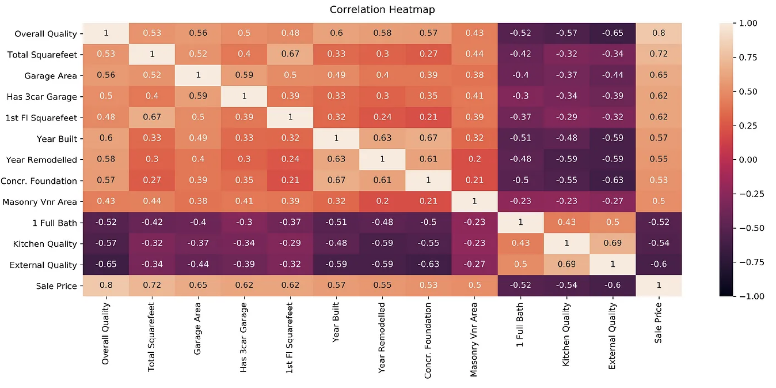
Correlation matrix and heatmap
Correlation = a statistical measurement of how related 2 variables are
Positive correlation (between 0 and1) = variables tend to increase or decrease together
Negative correlation (between -1 and 0) = one variable increases while the other decreases
Correlation close to zero = no relationship
Heatmap
Visualize pairs of relationships using
“heat” colors
https://medium.com/@szabo.bibor/how-to-create-a-seaborn-correlation-heatmap-in-python-834c0686b88e

Slide 5
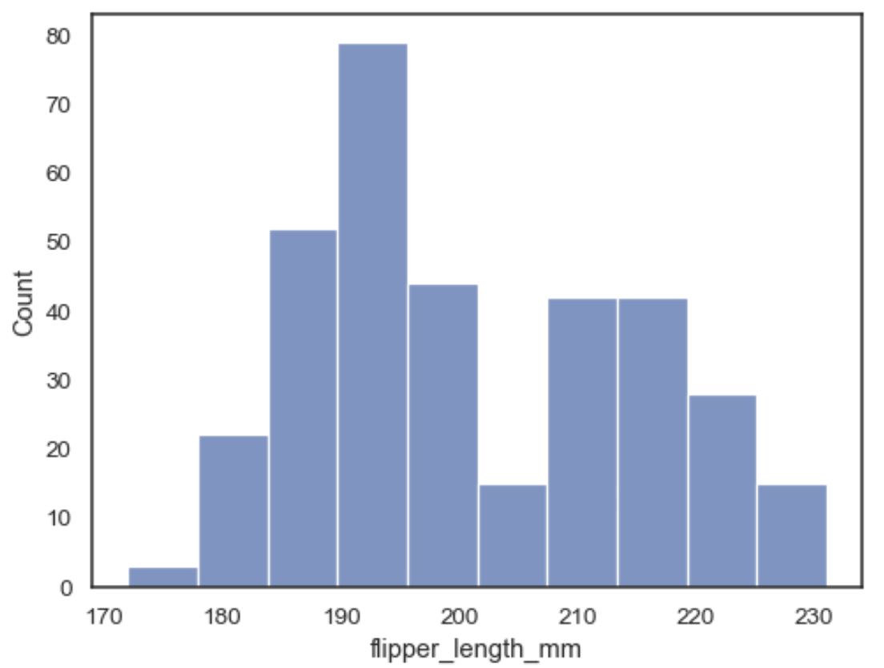
histogram
A type of bar graph that shows the distribution of numerical data
Each bar represents a range (or "bin") of values
The height of each bar shows how many data points fall within that range
X-axis = the variable being measured
Y-axis = the number of data points that fall in that bin
Flipper Length in a Penguin Population
Seaborn Python Library

Slide 6
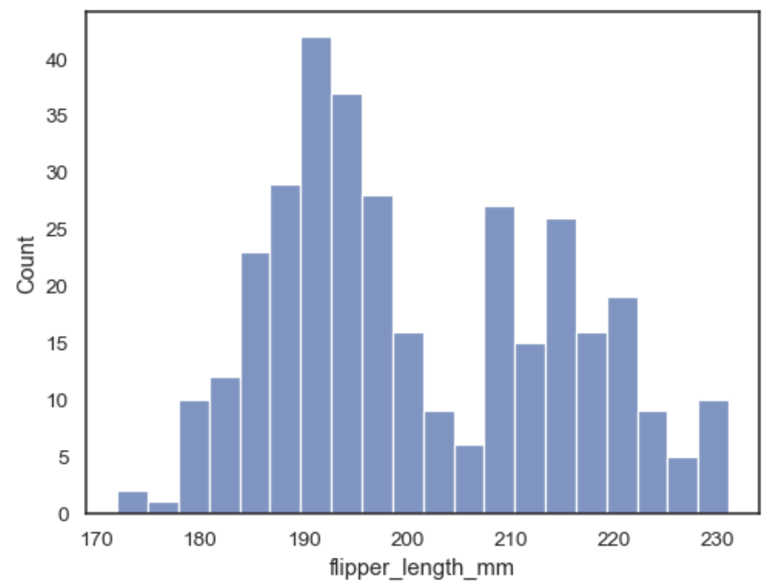
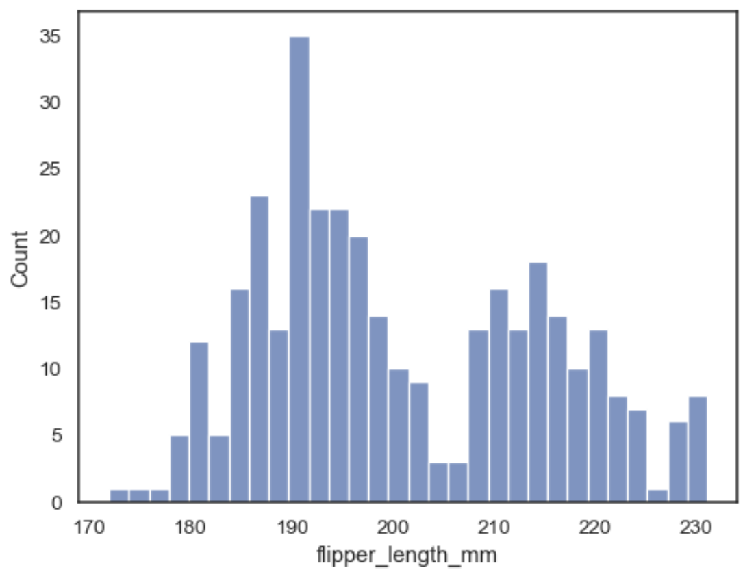
Histogram “bins”
Can specify different bin width or number of bins for a histogram
Specify bin width = 3
Specify number of bins = 30
Seaborn Python Library

Slide 7
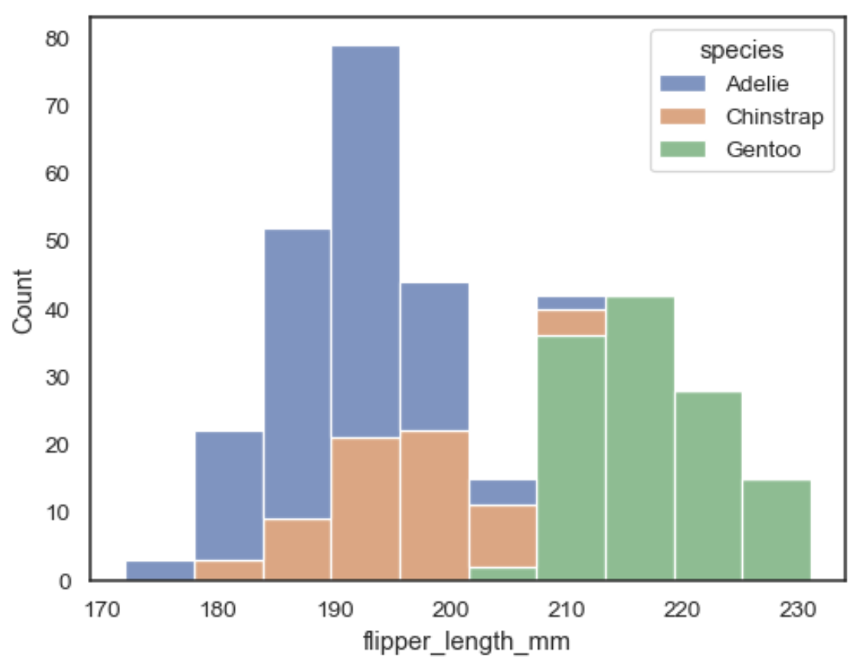
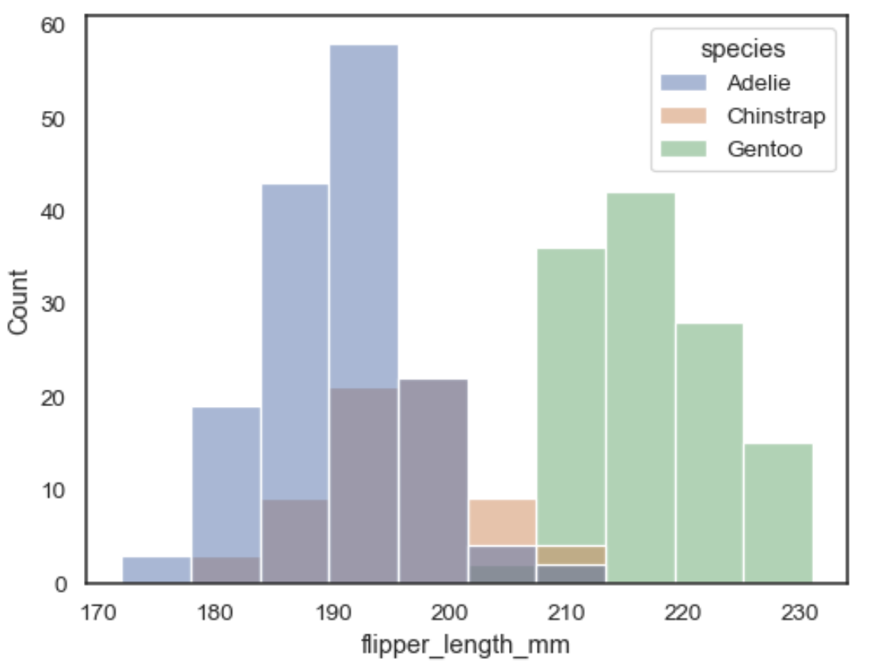
Multiple DatA DISTRIBUTIONS
Can plot multiple data distributions on the same histogram for comparison
Flipper Length in Different Penguin Species
Stacked
Layered
Seaborn Python Library

Slide 8
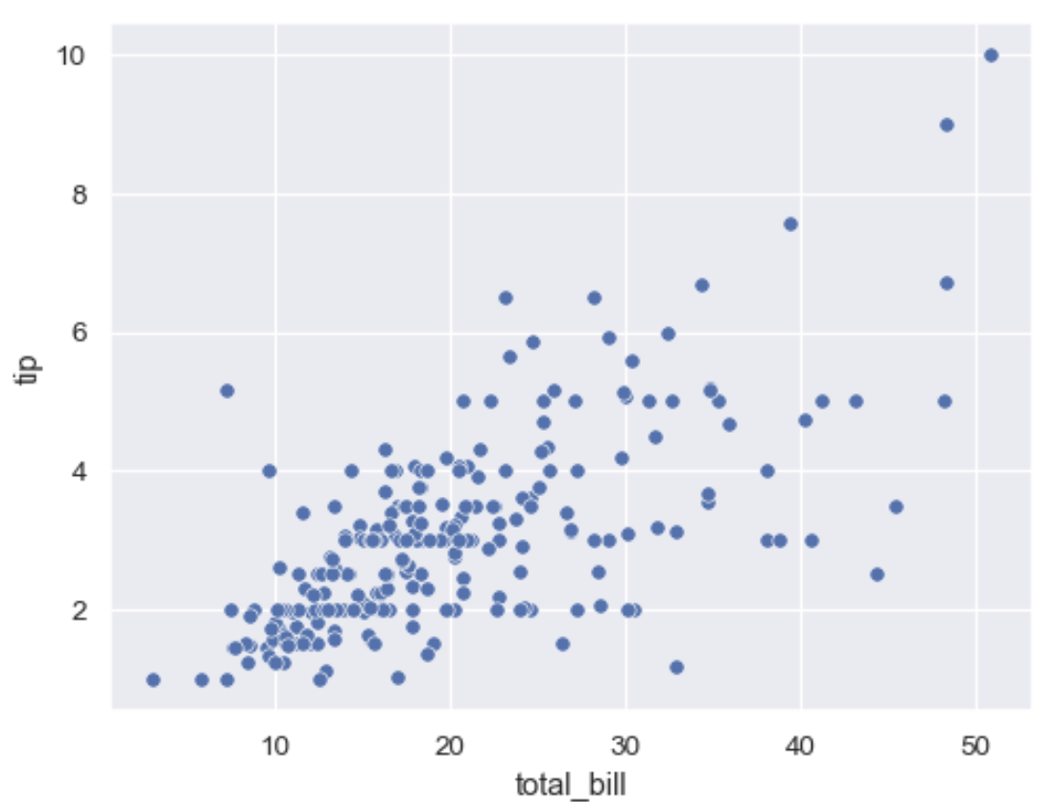
Scatter plot
Relationship of restaurant bill amount to tip amount
Shows the relationship between 2 variables
E.g. Positive correlation = trending bottom left to top right
X and Y axis show the values of each variable
The points in the plot are individual data points
Seaborn Python Library

Slide 9
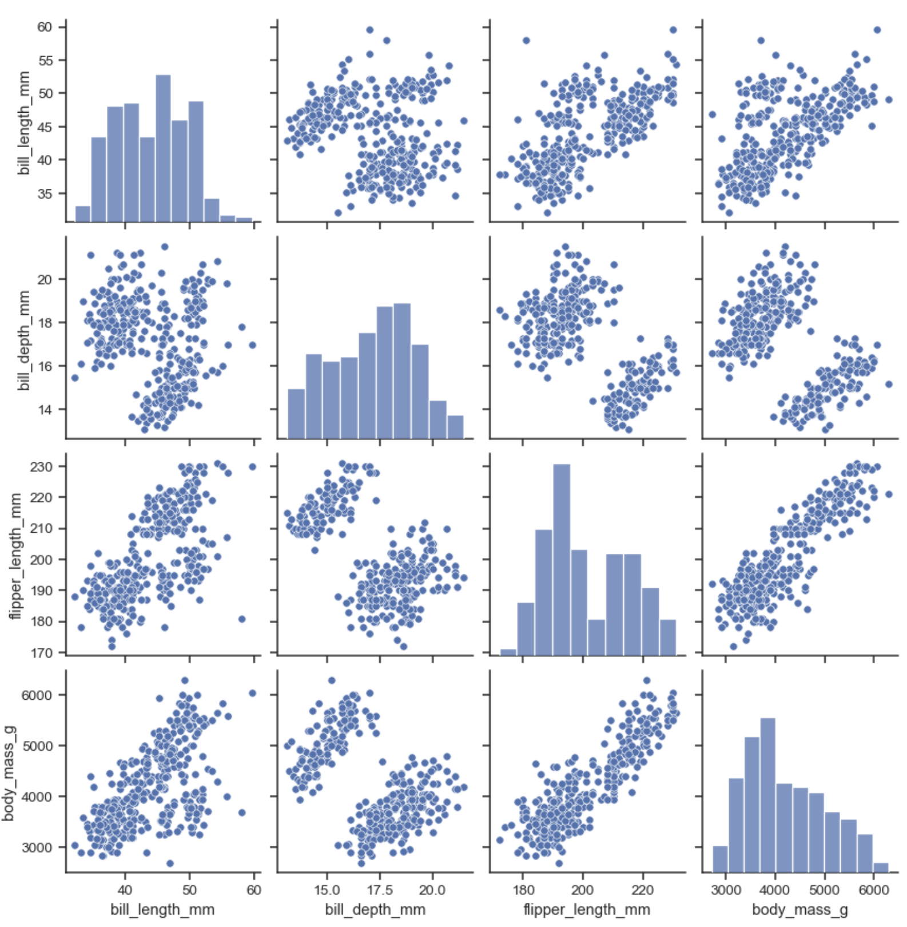
Pair plot
Combination of scatter plot and histogram
Plots the relationships between multiple pairs of variables on the same plot
Seaborn Python Library

